Slide 1
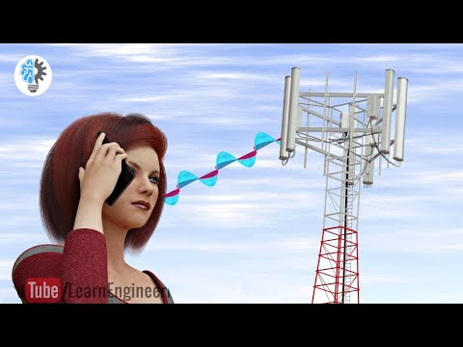
Introduction to mobile networks
-All of these require networks
Source: https://www.youtube.com/watch?v=1JZG9x_VOwA&t=4s

Slide 2
Networking: Computers on the Internet
1969 – 4
1971 – 15
1984 – 1000
1987 – 10,000
1989 – 100,000
1992 – 1,000,000
1996 – 10,000,000
2001 – 100,000,000
By 2005… billions

Slide 3
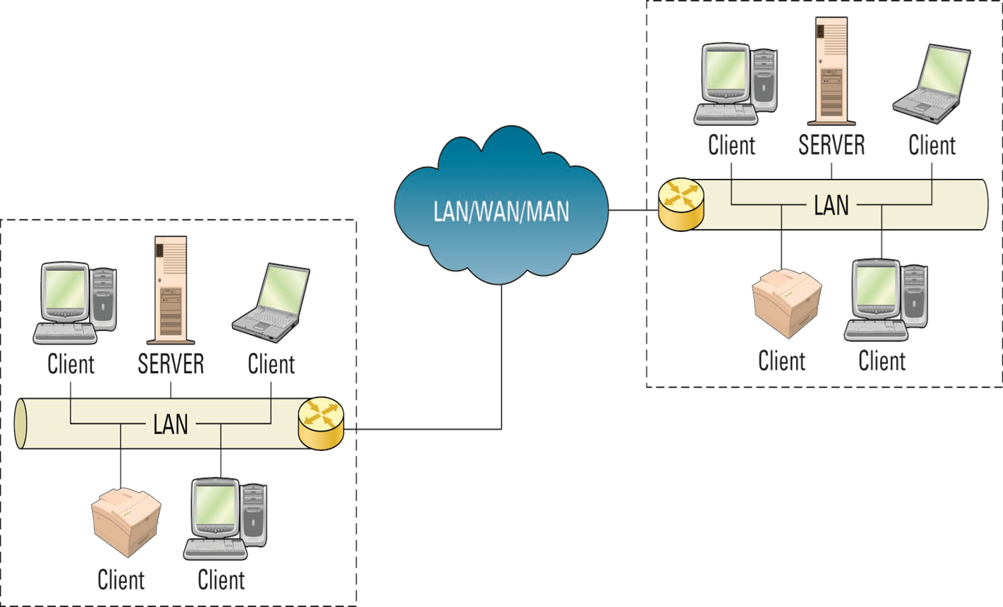
Client/Server Networks

Slide 4
Network Hardware
The most essential networking hardware devices are:
Cables
NICs
Hubs
Switches
Routers

Slide 5
Hardware & Power Interfaces

Slide 6
NIC – a “Network Interface Card”
Every networked device must have a NIC
Most laptops today have both a wired NIC and a wireless NIC
Each NIC has an IP address (it’s “logical address”) and a physical address called a MAC address.
Each NIC is given an address at the factory that is the device’s physical address or MAC address.
No two NIC devices will ever have the same MAC address.
MAC Addresses are used within a LAN
IP addresses allow routers to route a message across different networks
when a message reaches the correct destination network, the correct NIC is identified via its MAC address.

Slide 7
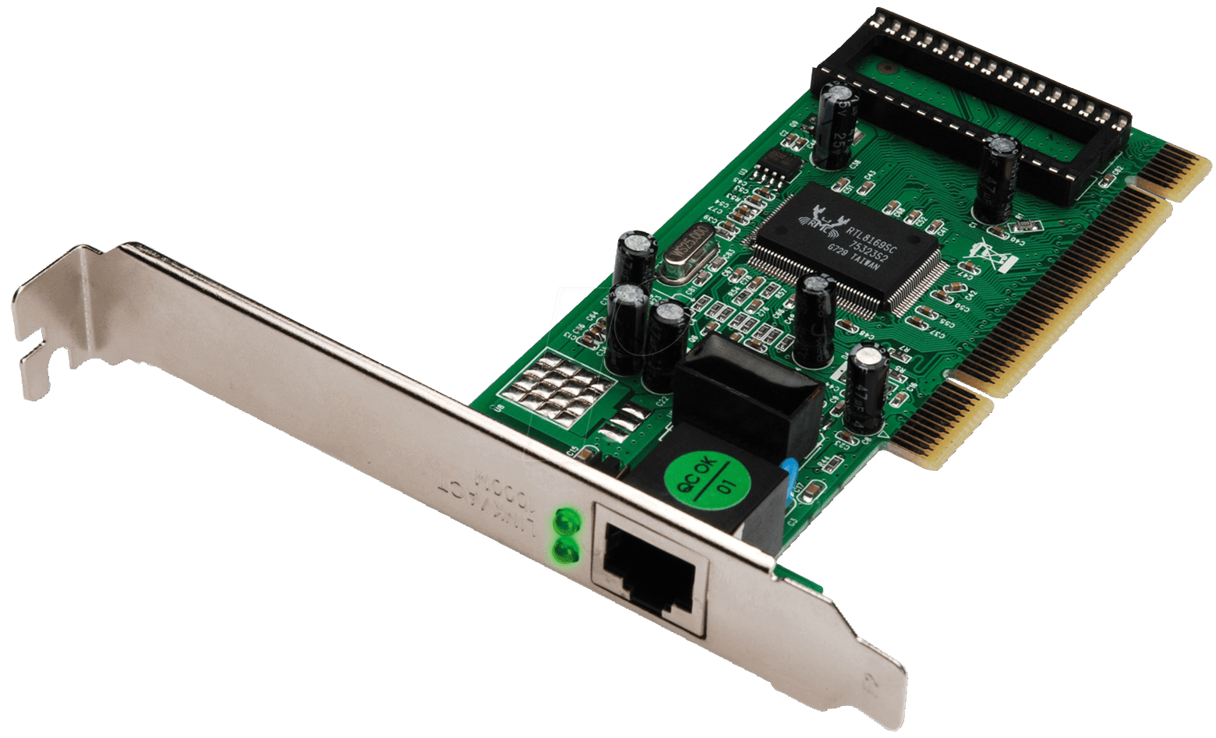
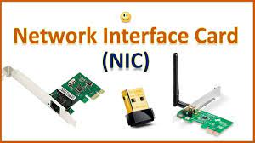
NIC – a “Network Interface Card”

Slide 8
Hubs
A “hub” is a networking component that into which you can plug in multiple network devices
Connect computers, printers, scanners, etc.
Anytime a connected device sends a network message, the hub forwards the message to all other connected devices (not just the intended recipient!)
Hub can only deal with one message at a time, since it is broadcast over all connections

Slide 9
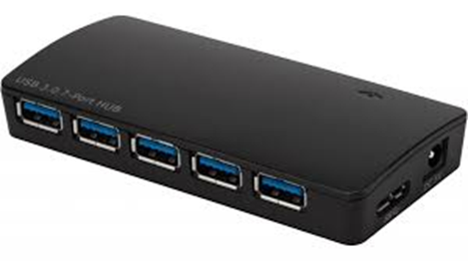
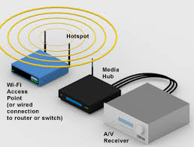
Hubs

Slide 10
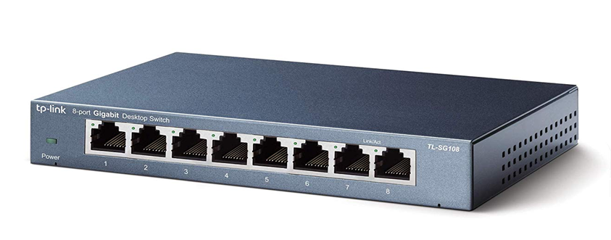
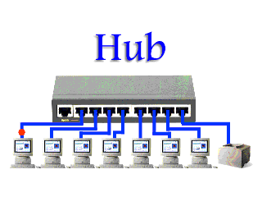
Switches -
A switch is a network device which directs traffic only to its intended destination(s) rather than to all devices on the network.
sometimes referred to as an “intelligent hub”
Provide a dedicated connection between individual devices
multiple devices can send data at once

Slide 11
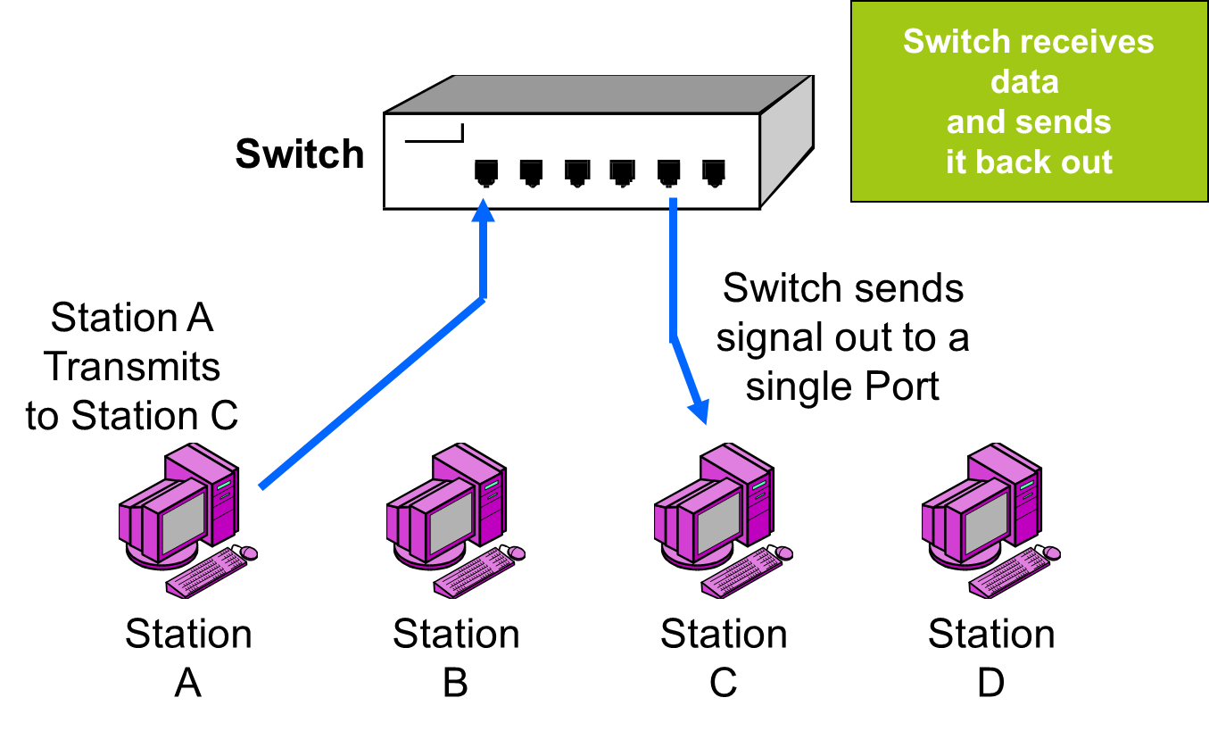
A Network Switch

Slide 12
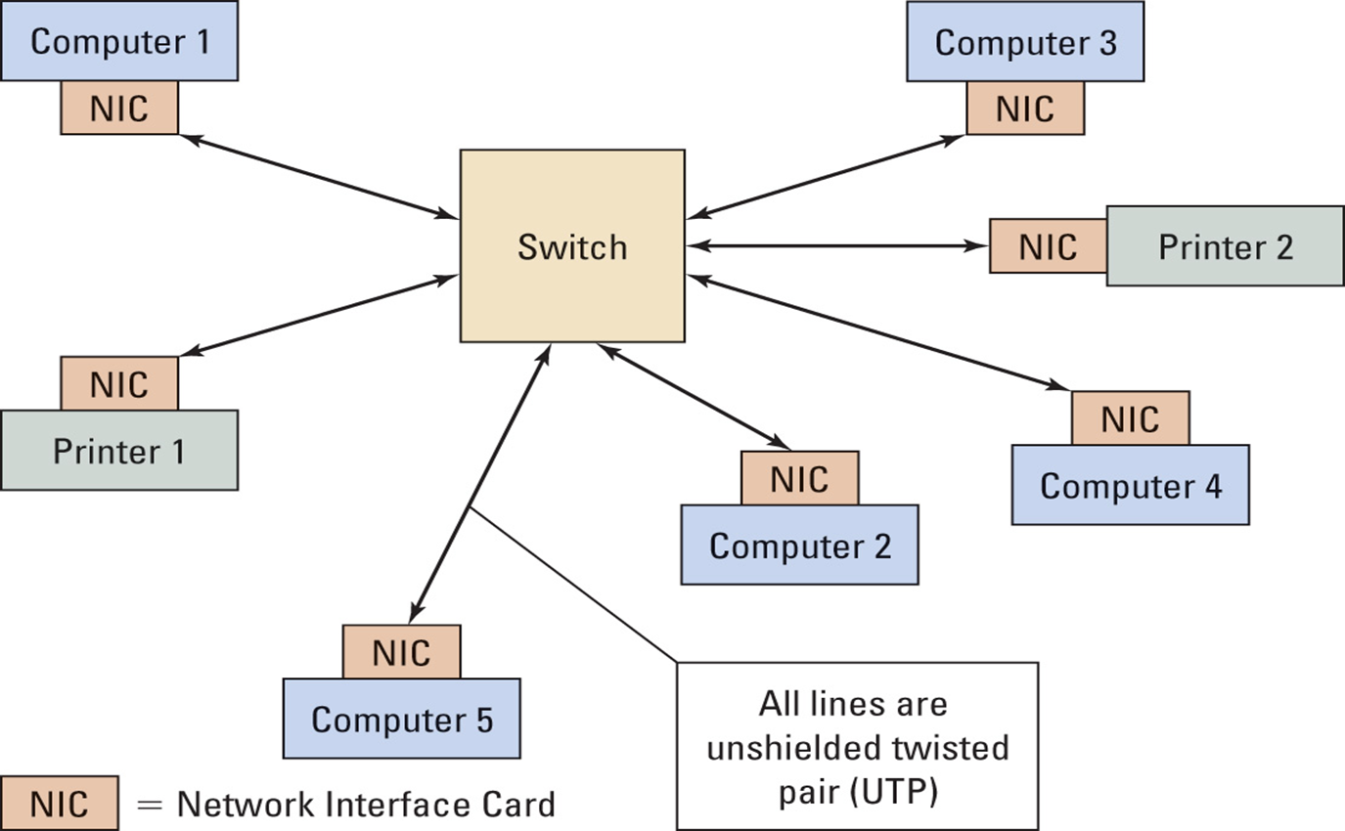
Typical LAN “Local Area Network”

Slide 13
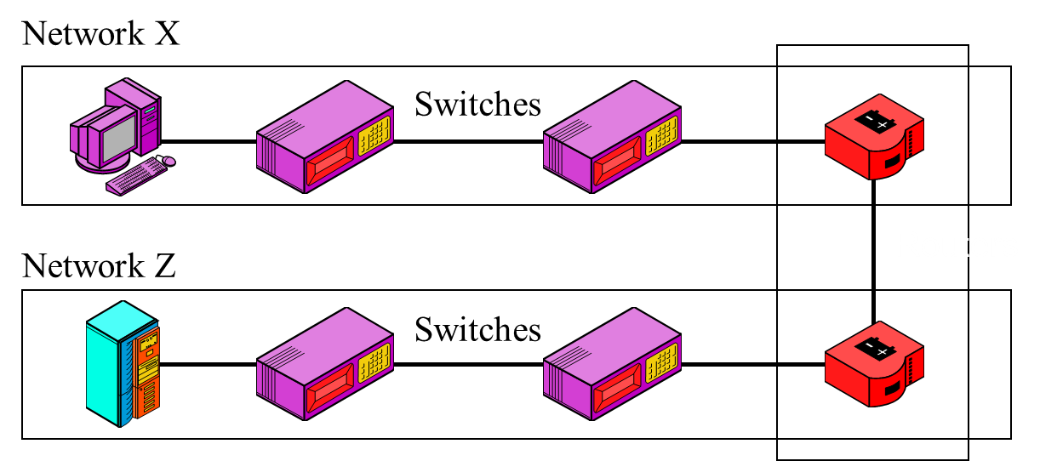
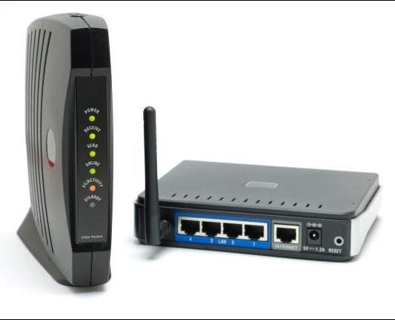
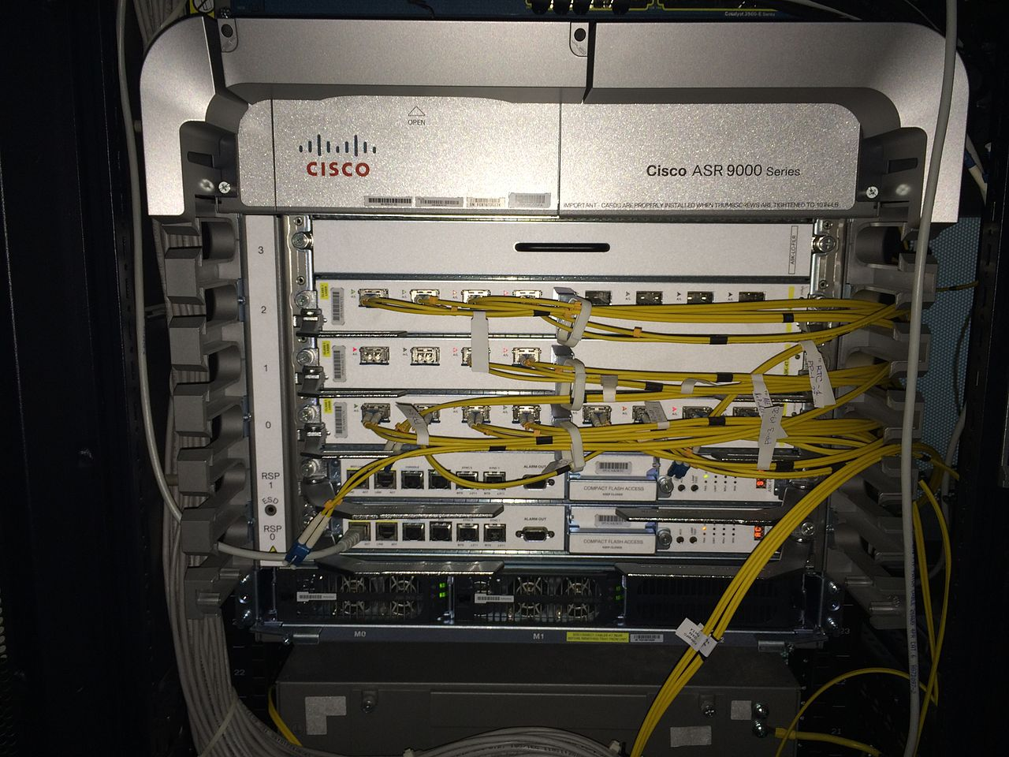
Routers
Different networks connect via routers (not switches or hubs)
Routers even connect networks based on different protocols, which is important since not all networks use the same protocol.

Slide 14
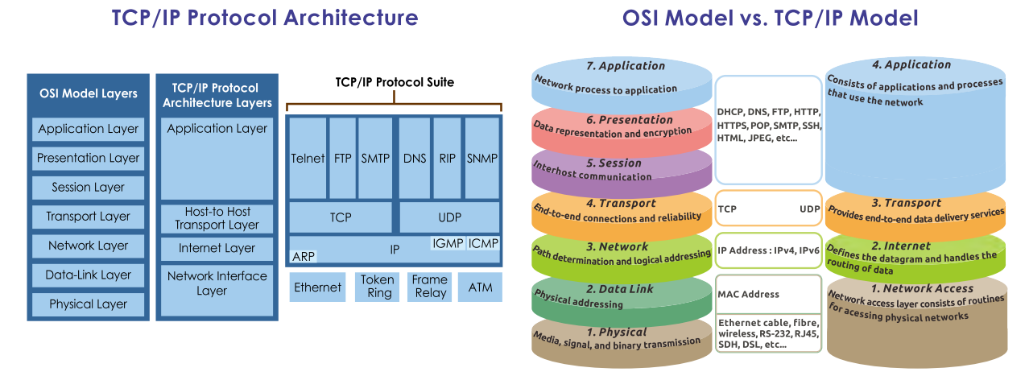
OSI Vs TCP/IP
Transmission Control Protocol/Internet Protocol (TCP/IP);
Open Systems Interconnection Model (OSI Model).
Please study from this page:
https://study-ccna.com/osi-tcp-ip-models/

Slide 15
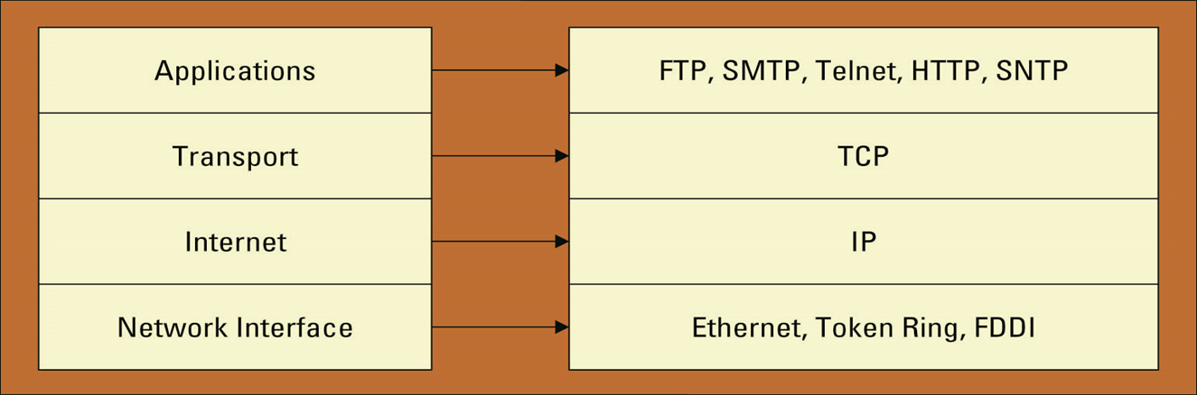
TCP/IP
Transmission Control Protocol/Internet Protocol (TCP/IP) provides the technical foundation for the public Internet as well as for large numbers of private network. It is defined in terms of layers.
Do you use TCP/IP?
If you are on the Internet, yes, you are using TCP/IP.
TCP/IP layers

Slide 16
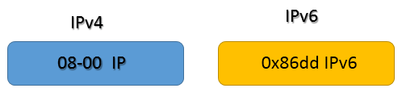
TCP/IP

Slide 17
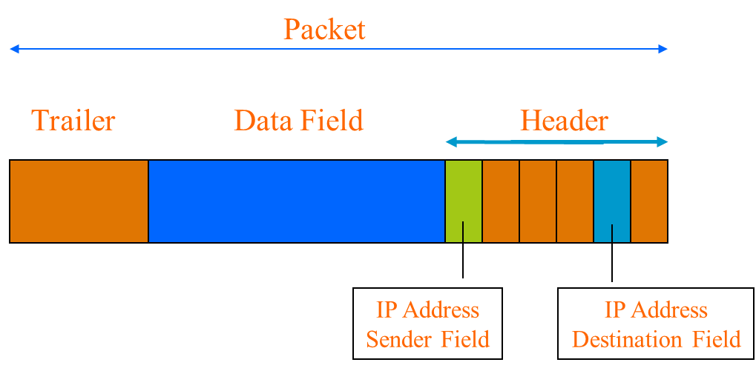
A TCP/IP network packet

Slide 18
LAN Technologies
Ethernet
Fast Ethernet
Gigabit Ethernet
10 Gig Ethernet
WLAN

Slide 19
Ethernet
Ethernet (pronounced "eether net") is a way of connecting computers and other network devices in a physical space. This is often referred to as a local area network or LAN.
The idea of an Ethernet network is that computers and other devices can share files, information and data between each other efficiently. Ethernet was released in 1980. Within each main branch of the network, "Ethernet" can connect up to 1,024 personal computers and workstations.

Slide 20
Ethernet
End nodes are identified by their Ethernet Addresses (MAC - Media Access Control Address or Hardware Address) which is a unique 6 Byte address.
MAC Address is represented in Hexadecimal format
e.g 00:05:5D:FE:10:0A
The first 3 bytes identify a vendor (also called prefix) and the last 3 bytes are unique for every host or device

Slide 21
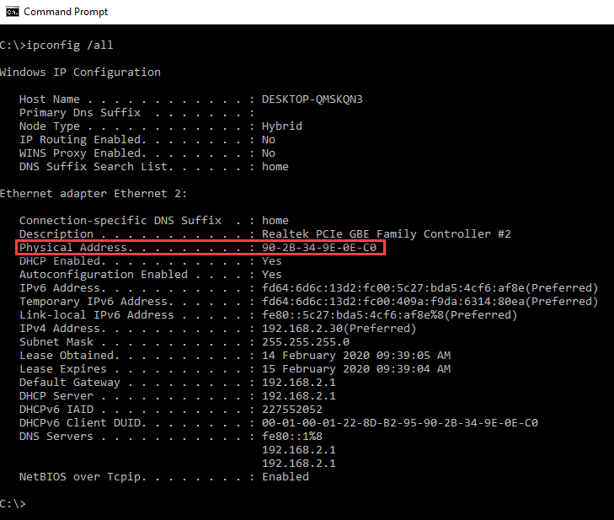
Ethernet
MAC - Media Access Control Address or Hardware Address
Source: https://www.guru99.com/what-is-mac-address.html

Slide 22

Ethernet Frame Structure
An Ethernet frame contains three parts
an Ethernet header (Preamble, SFD, Destination, Source, and Type),
Encapsulated data (Data and Pad), and
an Ethernet trailer (FCS).
The following image shows an example of an Ethernet frame.

Slide 23
Ethernet - preamble field, SFD field
The preamble field
The preamble field is 7 bytes long. It contains a string of 7 bytes. Each byte alternatively stores 1 and 0 to make the pattern '10101010'. Preamble bytes help the receiving device to identify the beginning of an Ethernet frame.
When a device receives 7 continuous bytes of the same pattern (10101010), it assumes that the incoming data is an Ethernet frame and it locks the incoming bit-stream.
The SFD field
The SFD (Start Frame Delimiter) field is 1 byte long. It contains a string of 1 byte. This byte also stores the same pattern, except the last bit. In the last bit, it stores 1 instead of the 0. The following image shows both fields with their related bytes respectively.

Slide 24
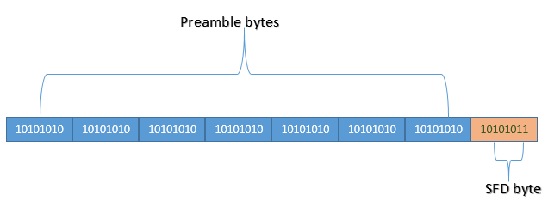
Ethernet - preamble field, SFD field
The following image shows both fields with their related bytes respectively.
The SFD byte indicates to the receiving device that the next byte is the destination MAC address of the Ethernet frame.

Slide 25
Ethernet - Destination MAC address
This field is 6 bytes long. It contains the MAC address of the destination device. MAC address is 6 bytes or 48 bits (1 byte = 8 bits, 6x8 = 48 bits) long.
For convenience, usually, it is written as 12-digit hexadecimal numbers (such as 0000.0A12.1234).
The destination MAC address allows the receiving device to determine whether an incoming frame is intended for it or not. If a frame is not intended for the receiving device, the receiving device discards that frame.

Slide 26
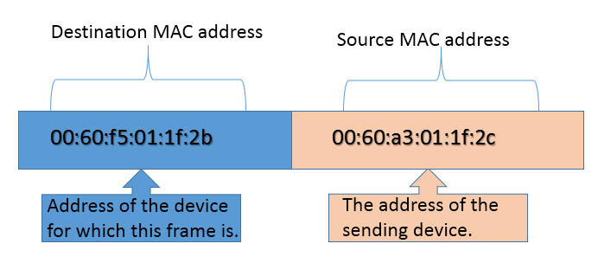
Ethernet - Source MAC address
This field is also 6 bytes long.
It contains the MAC address of the source device.
It helps the receiving device in identifying the source device.
The following image shows an example of both types of address in the frame

Slide 27
Ethernet - Type field
This field is 2 bytes long.
This field stores information about the protocol of the upper layer (network layer).
The Data Link layer of the source computer prepares, packs and loads the Ethernet frame in the media.
The Data link layer of the destination computer picks the Ethernet frame from the media.

Slide 28
Ethernet - Type field
After picking the Ethernet frame, the Data link layer of the destination computer unpacks, processes, and hands over that Ethernet frame to the upper layer for further processing.
If multiple protocols are running in the upper (network) layer of the destination computer, the data link layer will fail to hand over the received frame to the upper layer as it does not know to which protocol it should give the received frame.
To learn more about how layers exchange and process data, you can check this tutorial,
Data Encapsulation and De-encapsulation Explained
I’d say please read. It helps understand Aladdin’s cave!!

Slide 29
Ethernet -
The type field solves this issue. This field allows the sender computer to insert the information of the upper layer protocol. Through this information, the data link layer of the destination computer can easily determine the upper layer protocol to which it should hand over the received frame.
Modern LAN implementations mostly use the IP protocol in the network layer. There are two variants of the IP protocol; IPv4 and IPv6. If the type field has value IP or ox800, the frame is carrying the data of the IPv4 protocol. If the type field has value IPv6 or 0x86dd, the frame is carrying the data of the IPv6 protocol.

Slide 30
Ethernet - Data and Pad field
The following image shows an example of the type field for both IP variants.
Data and Pad field
This field stores the encapsulated data of the upper layer. This field has a size limit of 46 bytes (minimum) to 1500 bytes (maximum). Due to this limit, the network (upper) layer can't pack more or less data in a single packet (encapsulated data of the upper layer). If data is less than the minimum requirement, padding is added. If data is more than the maximum limit, extra data is packed in the next packet.

Slide 31
Ethernet - FCS (Frame Check Sequence)
This field is 4 bytes long. This field stores a 4 bytes value that is used to check whether the received frame is intact or not. The sender device takes all fields of the frame except the FCS field, and runs them through an algorithm, known as the CRC (Cyclic Redundancy Check). The CRC algorithm generates a 4-byte result, which is placed in this FCS field.
When the destination device receives a frame, it takes the same fields and runs them through the same algorithm. If the result matches with the value stored in the FCS field, the frame is considered good and is processed further. If both values do not match, the frame is considered bad and is dropped.

Slide 32
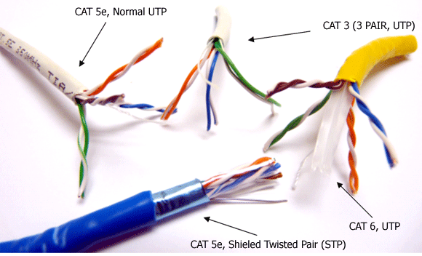
Ethernet - Fast Ethernet
100 Mbps bandwidth
Uses same CSMA/CD media access protocol and packet format as in Ethernet.
100BaseTX (UTP) and 100BaseFX (Fiber) standards
Full Duplex/Half Duplex operations.

Slide 33
Fast Ethernet - Important Terms
100: In 100 Base, 100 stands for 100 Mega Hertz or 100 MHz, which translates to 100 mbit/seconds. This 100 mbit/seconds theoretically points to 12 Mbps; however, you may not get more than 4 Mbps in real. .
Base: This is the term for Baseband, which is mainly used to depict the communication used by the Ethernet. It depicts that the cable is using all the available bandwidth to transmit the data. Against this, in broadband the cable usually shares the bandwidth. This is one of the reasons why users may face some slowdown at times when multiple users are connected to the network. Although Ethernet users may also experience some slowdown, is the frequency is lesser compared to broadband.

Slide 34
Fast Ethernet - Important Terms
100Base TX: The term TX is sometimes referred to as T is term for Twisted Pair, which is a type of physical signal carried by the cable. This TX shows that the application is utilizing CAT5 UTP cables, where two pairs of copper wires are being used to support speed of 100 mbit/s. The 100 Base-TX cables can support data speeds up to 100 meters and must possess minimum recommended node length of 2.5 meters between two cables.
100Base FX: In FX, the cable uses two pairs of fiber to support more than 100 Mbps. This cable can support a speed up to 2 km, which makes it an ideal choice for long distance applications.

Slide 35
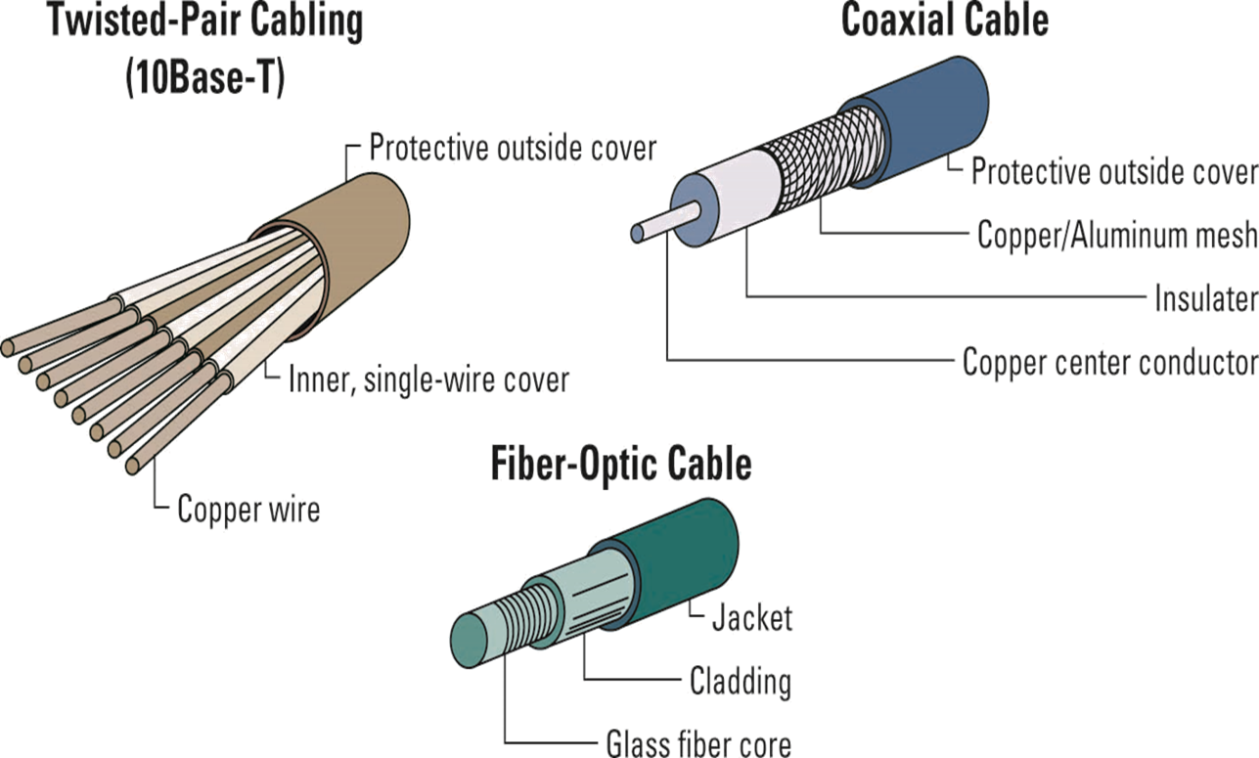
Ethernet Wire Media

Slide 36
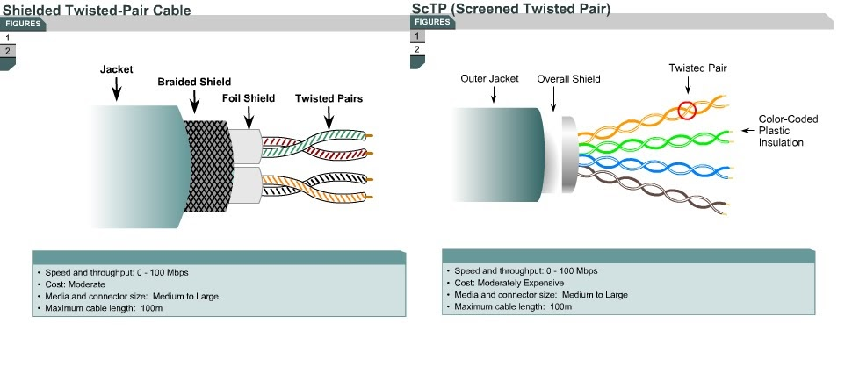
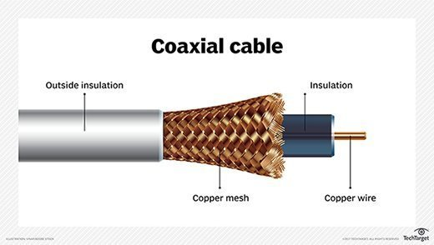
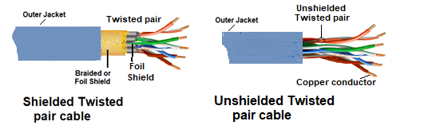
Ethernet - Wire Media

Slide 37
Fast Ethernet - CSMA/CD and CSMA/CA
CSMA/CD and CSMA/CA are the media access methods that govern how a device can transmit data to the network. CSMA/CD stands for Carrier Sense Multiple Access / Collision Detection. CSMA/CA stands for Carrier Sense Multiple Access/Collision Avoidance.
Both methods are used in a single collision domain. A single collision domain is a group of devices that share a collision. Since all devices share a collision, they use a method to avoid and remove the collision. Based on the media type used in the network, this method is known as either CSMA/CD or as CSMA/CA.If the network uses wired media, this method is known as CSMA/CD. If the network uses wireless media, this method is known as CSMA/CA.

Slide 38
Fast Ethernet - CSMA/CD - Carrier Sense
In a single collision domain, only one NIC can send a frame at a time.
All NICs, however, can simultaneously listen to the frame on the wire.
Before a NIC puts a frame on the wire, it first senses the wire to ensure that no other frame is currently on the wire.
If it is a copper wire, the NIC can detect the frame by examining the voltage levels on the wire. If it is a fiber wire, the NIC can detect the frame by examining the light frequencies on the wire. This process is known as carrier sense.

Slide 39
Fast Ethernet - CSMA/CD - Multiple Access
If a NIC detects a frame on the wire, it waits until the frame is transmitted.
A NIC transmits a frame only when it detects no frame on the wire.
Sometimes two or more NICs may accidentally detect no frame at the same time.
For example, two NICs want to transmit frames, and there is no frame on the wire. Since there is no frame on the wire, both NICs put their frames on the wire at the same time. This process is known as multiple access.

Slide 40
Ethernet - CSMA/CD - Collision Detection
If two or more NICs simultaneously sense the wire and see no frame, and each places its frame on the wire, a collision will occur. In this situation, the voltage levels on a copper wire and the light frequencies on a fiber wire get messed up. For example, if two NICs put the same voltage on the electrical part of the wire, the voltage level will be different from that of only one device. The two original frames become indecipherable. This process is known as collision detection.

Slide 41
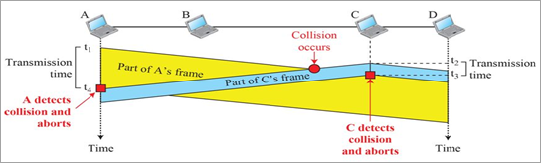
Ethernet - CSMA/CD - Collision Detection
Let's take a simple a simple example. There are four PCs in a single collision domain. PC-A sends data to PC-D. Next, PC-C sends data to PC-A and D. Since both PC-A and PC-C put their frames on the wire at the same time, a collision will occur.

Slide 42
Ethernet - CSMA/CD - Collision Detection
This mechanism is only used in a single collision domain.
All devices have equal priority.
In this process, only one device can send data at a time.
Before a device sends data, it will first sense the wire to ensure that no other device is currently sending data. If another device is currently using the media, it will have to wait till that transmission is over. If no device is currently using wire it can send the data.
If two or more devices simultaneously sense wire and see no data in it, they could place their data on the wire at the same time.
In this situation, a collision will occur.

Slide 43
Ethernet - CSMA/CD - Collision Detection
When a collision occurs, a special jam signal is created in the wire.
Jam signal has a waiting time.
All devices have to wait till the jam signal time is over.
Once this time is over, devices can sense the wire again.
If a device's data is lost in the collision, the device sends the same piece of data again.

Slide 44
Ethernet - CSMA/CD - Collision Detection
CSMA/CD is standardized for transmission in Ethernet 802.3 network channel.
CSMA/CD has no mechanism to avoid the collision rather react to it as it occurs.
As a result when collision is persistent due to network congestion, its performance drop and more capacity is not utilized when long frames are transmitted in the channel.

Slide 45
Ethernet - CSMA/CA
WLANs use a mechanism called Carrier Sense, Multiple Access/Collision Avoidance (CSMA/CA).
Unlike Ethernet, it is impossible to detect collisions in a wireless medium.
In a WLAN, a device cannot simultaneously send or receive data. It can only do one or the other. Because of this, it cannot detect a collision.
To avoid collisions, a device will use Ready-to-Send (RTS) and Clear-to-Send (CTS) signals. When a device is ready to transmit, it first senses the airwaves for a current signal. If there is none, it generates an RTS signal, indicating that data is about to send.
It then sends its data and finishes by sending a CTS signal, indicating that another wireless device can now transmit.

Slide 46
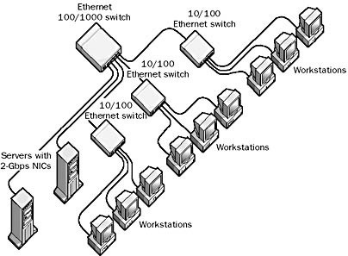
Gigabit Ethernet
1 Gbps bandwidth.
Uses same CSMA/CD media access protocol as in Ethernet and is backward compatible (10/100/100 modules are available).
1000BaseT (UTP), 1000BaseSX (Multimode Fiber) and 1000BaseLX (Multimode/Singlemode Fiber) standards.

Slide 47
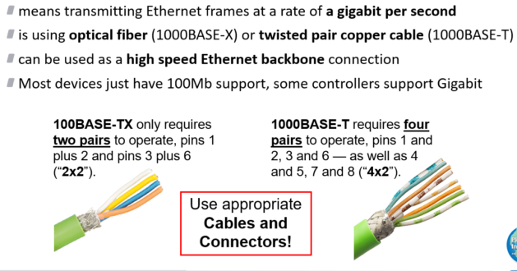
Gigabit Ethernet

Slide 48
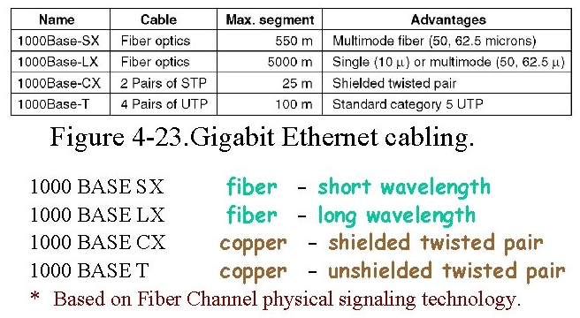
Gigabit Ethernet

Slide 49
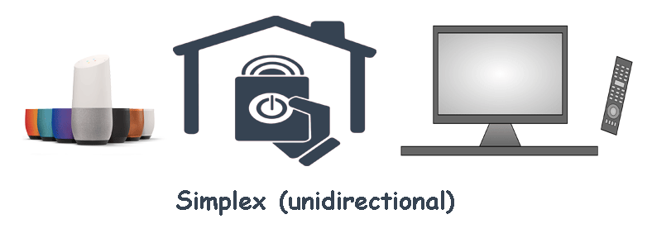
Data Transmission - Simplex, Half Duplex & Full Duplex
https://www.computernetworkingnotes.com/networking-tutorials/simplex-half-duplex-and-full-duplex-explained.html

Slide 50
Data Transmission - Simplex
Simplex is also called one-way or unidirectional. It allows communication in one direction only. Since signals travel in only one direction, the sender device uses the entire communication channel or all available bandwidth. The receiver device only receives signals. The receiver can't reply to the sender by using the same communication channel. TV remotes, garage door openers, and smart speakers are some examples of Simplex.
You can use the remote to control TV programs and functions, but you can't use the TV to control the remote in any way.

Slide 51
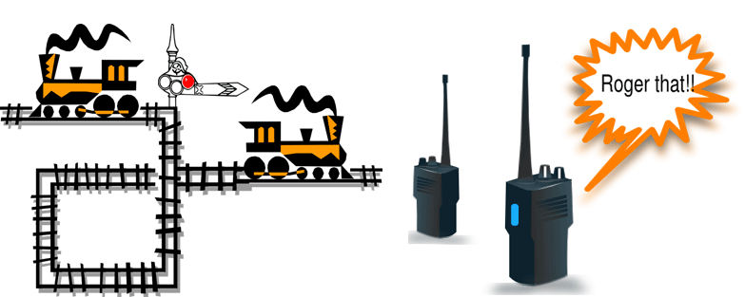
Data Transmission - Half Duplex

Slide 52
Data Transmission - Half Duplex
Half-duplex allows communication in both directions but not at the same time. Signals travel in both directions over a medium but in one direction only at a time. Since signals travel in only one direction, a device can either send or receive data at a given time.
A network card set to Half-duplex cannot receive data when it is sending data. To receive data, it needs to change the direction of data flow. To change direction, a special signal is used and acknowledged. The time required to turn over control to the other side is called the line turnaround time.
Railway tracks and walkie-talkies are examples of half-duplex. Only one train can run on a railway track at a time. If a train is on the track, the second train has to wait until the first train leaves the track.

Slide 53
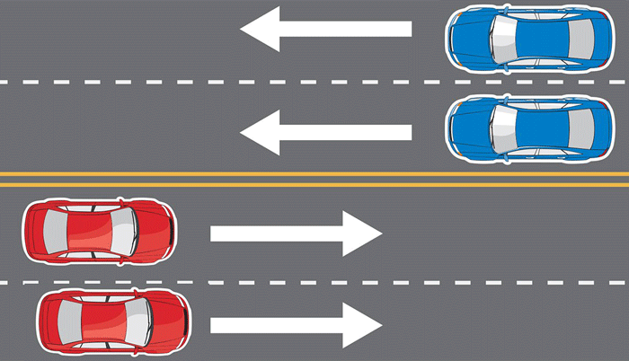
Data Transmission - Full Duplex

Slide 54
Data Transmission - Full Duplex
Full-duplex is also called two-way or bidirectional. It allows communication in both directions simultaneously.
It divides the available channel into two parts and uses one part to send data and the other part to receive data. Since there is a separate path for sending and receiving data, a device can simultaneously perform both tasks at a given time.
A two-lane highway is an example of a full-duplex. A two-lane highway uses dedicated lanes for incoming and outgoing traffic.

Slide 55
Simplex | Half-duplex | Full-duplex
It provides one-way communication. | It provides two-way communication but one way at a time. | It provides two-way communication at the same time.
A device can only send data, but it cannot receive data. | A device can send and receive data but one at a time. | A device can send and receive data at the same time.
It utilizes less bandwidth than half-duplex and full-duplex. | It utilizes more bandwidth than simplex but less than full-duplex. | It utilizes more bandwidth than simplex and half-duplex.
It uses one channel to transmit data. | It also uses one channel to transmit data. | It uses two separate channels to transmit data.
Keyboards and scanners are examples of simplex. | Hubs and old NICs are examples of half-duplex. | Switches and modern NICs are examples of full-duplex.

Slide 56
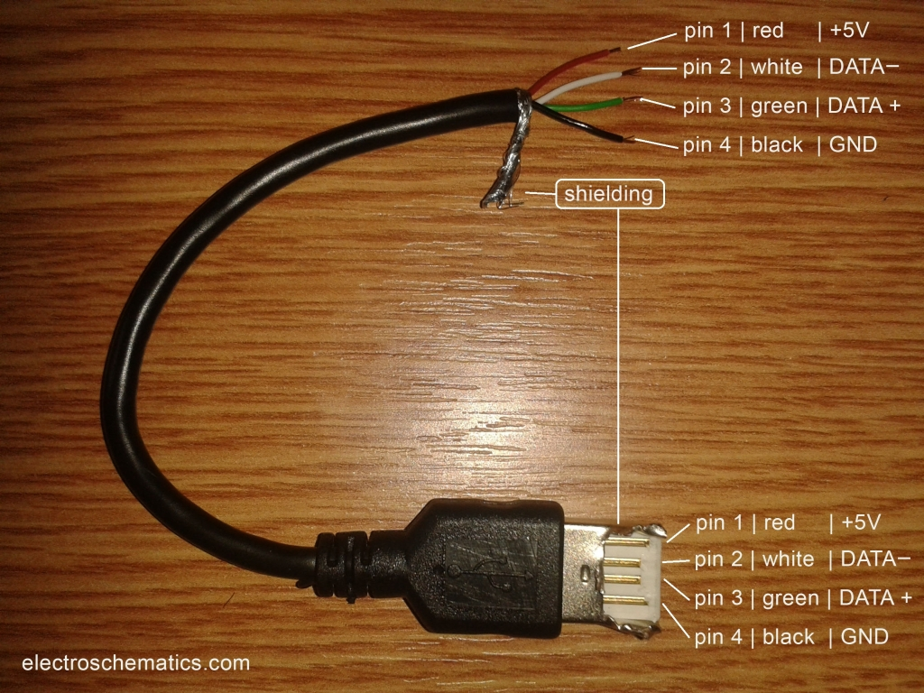
USB
https://www.electroschematics.com/usb-how-things-work/

Slide 57
USB
USB is the short form of Universal Serial Bus, a standard port that helps to connect computer peripherals like scanner, printer, digital camera, flash drive and more to the Computer.The easiest way to connect computer peripherals.
The USB is a plug-and-play interface between the PC and the peripherals.
The main advantage of USB is that the device can be plugged in or plugged out without the need of restarting the PC
The USB standard supports the data transfer at the rate of 12 Mbps.

Slide 58
USB - Specification
Two important aspects are its support capability and total bandwidth.
It is capable of supporting 127 devices and has a total bandwidth of 12 Mbit per second which is equal to 1.5 MB per second.
Working of a 12 Mbit (full speed device) or a 1.5 Mbit (low speed devices) depends on the total bandwidth of the USB.
USB 2.0 has a maximum signaling rate of 480 Mbit/s and USB 3.0 has a usable data rate of up to 4 Gbit/s (500 MB/s).

Slide 59
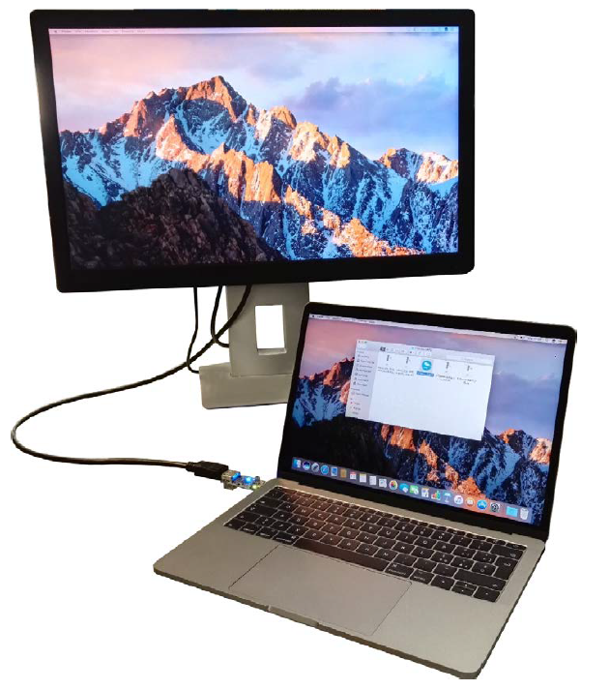
USB-C to HDMI
https://www.st.com/resource/en/user_manual/um2355-stevalusbc2dp-usb-typec-to-displayport-adapter-stmicroelectronics.pdf

Slide 60
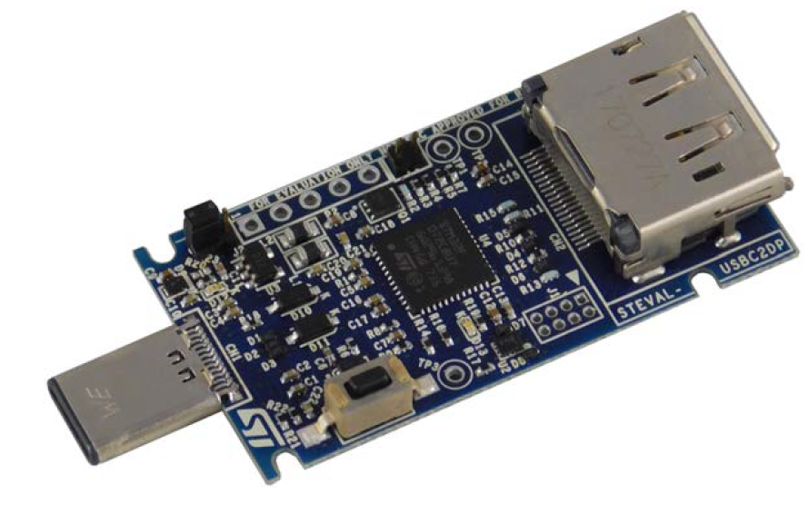
USB-C to HDMI
https://www.st.com/resource/en/user_manual/um2355-stevalusbc2dp-usb-typec-to-displayport-adapter-stmicroelectronics.pdf

Slide 61
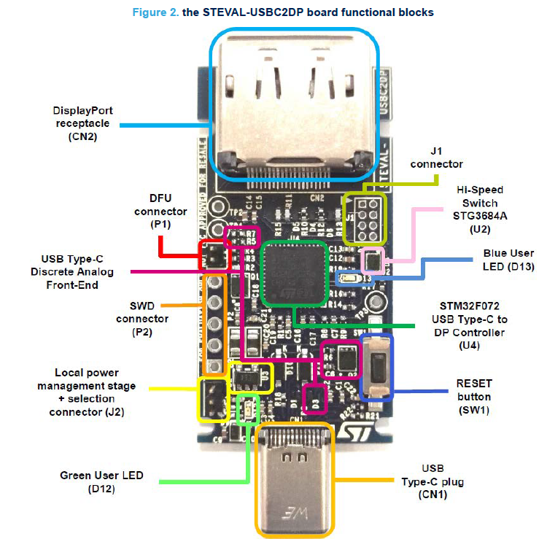
USB-C to HDMI
SWD stands for Serial Wire Debug is the protocol designed by ARM for programming and debugging their microcontrollers.
USB Device Firmware Upgrade (DFU) standard is an official USB device class specification of the USB Implementers Forum. It specifies a vendor and device independent way of updating the firmware of a USB device

Slide 62
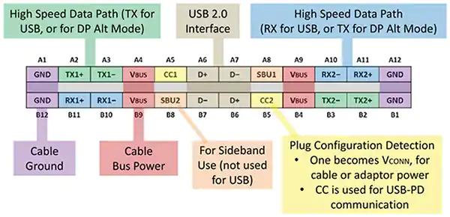
USB-C to HDMI
https://www.st.com/resource/en/technical_article/ta0356-usb-typec-and-power-delivery-displayport-alternate-mode-stmicroelectronics.pdf

Slide 63
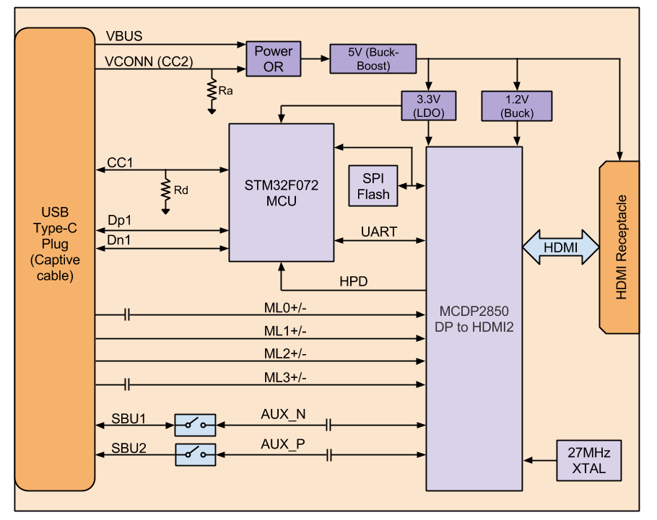
USB -C to HDMI
https://www.chromium.org/chromium-os/hoho/

Slide 64
USB-C to HDMI - Pin Terms
The 24-pin USB Type-C connector can be divided into seven functional types:
VBUS: four power pins allowing up to 20 V
CCx: two configuration channels for protocol communication
VCONN: supplies the cable configuration IC (on the receptacle, it is one of the CC pins)
SuperSpeed Lane1: with RX differential pair RX1p, RX1n and TX differential pair TX1p, TX1n
SuperSpeed Lane2: with RX differential pair RX2p, RX2n and TX differential pair TX2p, TX2n
SBU1,2: side band lines for alternate modes
Dp, Dn: USB 2.0 high speed signals
GND: four ground pins

Slide 65
USB-C to HDMI - Terms
VBUS pins carry power to and from the platform, while the VCONN pin on the plug supplies 5 V (up to 1 W) to the IC via the electronically-marked Type-C cable.
The configuration channel (CC) pins are used to exchange messages according to the USB PD specification.
DisplayPort Alternate Mode uses the SuperSpeed lanes to implement the DisplayPort protocol: the four sets of SuperSpeed USB3.1 Lanes with eight pins for high-speed data transfer (green TX1+, TX1-, TX2+ and TX2- pins and blue RX1+, RX1-, RX2+ and RX2- pins) establish the connection between the four DP links and the four sets of high-speed data cables.

Slide 66
USB-C to HDMI - Terms
In the type-C connector, the SBU or Secondary Bus pins are data paths for the DisplayPort AUX channel and hot plug detection (HPD).
DisplayPort source and sink devices use the AUX Channel for device linking and management, while DP sink devices implement HPD with vendor-defined messages (VDM) to signal their presence or to request the attention of the DP source.
The Type-C connector pins D+ and D- support legacy USB2.0 peripherals. These pins are not configurable, and are used to manage the USB2.0 data bandwidths. These pins can be used to set the USB Enumeration in the hosting platform for serial communication, or for the DFU feature.

Slide 67
USB-C to HDMI -UART (Universal asynchronous receiver-transmitter)
UART is a hardware communication protocol that uses asynchronous serial communication with configurable speed. Asynchronous means there is no clock signal to synchronize the output bits from the transmitting device going to the receiving end.
The universal asynchronous receiver-transmitter (UART) takes bytes of data and transmits the individual bits in a sequential fashion. At the destination, a second UART re-assembles the bits into complete bytes.
Communication may be 3 modes:
simplex (in one direction only, with no provision for the receiving device to send information back to the transmitting device)
full duplex (both devices send and receive at the same time)
half duplex (devices take turns transmitting and receiving)

Slide 68
USB-C to HDMI - Terms
A buck-boost converter produces a DC output voltage that can be either bigger or smaller in magnitude than its DC input voltage. As its name suggests, it combines the functions of a buck converter (used for DC voltage step-down) and a boost converter (used for DC voltage step-up).
Hot-plugging a device means the device is added or removed without shutting down the operating system or powering off the system. When you hot-plug a USB device, the device is immediately seen in the system's device hierarchy, as displayed in the prtconf command output.

Slide 69
USB-C to HDMI - Terms
SPI stands for Serial Peripheral Interface. It’s a simple serial protocol that can talk to a variety of devices, including serial flash devices.
Flash memory is a type of non-volatile storage that is electrically eraseable and rewriteable.
SPI flash modules are handy because they’re low cost and have a small footprint. SPI interfaces can be moderately fast by cheap embedded controller standards (133MHz). Some support 2-bit and 4-bit data buses as well, increasing transfer rates further over a pure serial interface.

Slide 70
USB-C to HDMI - Local power management stage and LEDs
As the adapter shall have the sink role and start up under Dead Battery Mode, the local power management stage supplies the board through an LDK220 voltage regulator from the VBUS or VCONN voltage supply lines on the host USB receptacle.
The LDK220 low quiescent current and low noise LDO supplies a maximum 200 mA output from a 2.5 V to 13.2 V input range, with a typical drop-out voltage of 100 mV.
LDO, which stands for Low Dropout, can operate at a low potential difference between input and output. It is sometimes referred to as a low-loss or saturation type linear regulator.

Slide 71
USB-C to HDMI - LEDs
The STEVAL-USBC2DP platform includes the following status LEDs:
1. Green LED D12 to signal that the platform is powered.
2. Blue LED D13 (connected to the STM32F072 PA7 pin) to signal the status of the Alternative Mode operation

Slide 72
Wireless Networks

Slide 73
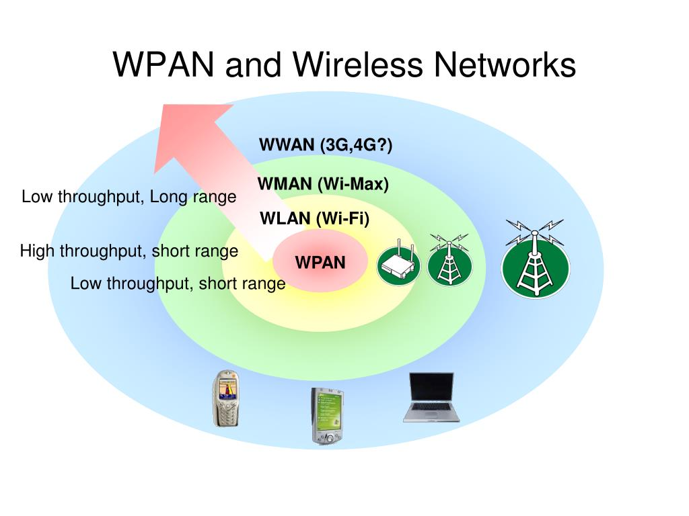
Wireless Network - Types
Bluetooth
Wireless fidelity (wi-fi) – a means of linking computers into a wireless local area network (WLAN)
Wi-Max
https://image2.slideserve.com/5148429/wpan-and-wireless-networks-l.jpg

Slide 74
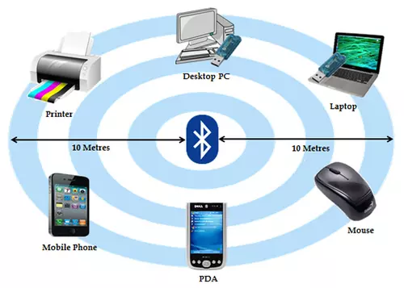
WPAN
Wireless PAN or WPAN – Wireless Personal Area Network
WPAN vs. WLAN
smaller coverage area (~10 m)
lower data rate (~1 Mbps)
ad hoc only topology
lower power consumption (~1 mW)
https://ccm.net/contents/834-wpan-wireless-personal-area-network

Slide 75
WPAN - Types
Bluetooth
HomeRF (Home Radio Frequency
ZigBee (also known as IEEE 802.15.4)
Infrared
Wireless USB

Slide 76
WPAN
Bluetooth:the main WPAN technology is Bluetooth, launched by Ericsson in 1994, which offers a maximum throughput of 1 Mbps over a maximum range of about thirty metres. Bluetooth, also known as IEEE 802.15.1, has the advantage of being very energy-efficient, which makes it particularly well-suited to use in small devices.
HomeRF (for Home Radio Frequency), launched in 1998 by HomeRF Working Group, has a maximum throughput of 10 Mbps with a range of about 50 to 100 metres without an amplifier. The HomeRF standard, despite Intel's support, was abandoned in January 2003, largely because processor manufacturers had started to support on-board Wi-Fi (via Centrino technology, which included a microprocessor and a Wi-Fi adapter on a single component).

Slide 77
WPAN
ZigBee (also known as IEEE 802.15.4): it can be used to connect devices wirelessly at a very low cost and with little energy consumption, which makes it particularly well-suited for being directly integrated into small electronic appliances (like home appliances, stereos, and toys).
It operates on the frequency band of 2.4 GHz and on 16 channels, can reach transfer speeds of up to 250 Kbps with a maximum range of about 100 metres.

Slide 78
WPAN
Ultra-low power, low-data rate, industrial monitoring and control applications requiring small amounts of data, turned off most of the time (<1% duty cycle),
e.g., wireless light switches, meter reading, patient monitoring
IEEE 802.15.4
Less Complex. 32kB protocol stack vs 250kB for Bluetooth
Range: 1 to 100 m, up to 65000 nodes.
Tri-Band -
16 Channels at 250 kbps in 2.4GHz ISM
10 Channels at 40 kb/s in 915 MHz ISM band
One Channel at 20 kb/s in European 868 MHz band
! Ref: ZigBee Alliance, http://www.ZigBee.org

Slide 79
WPAN
Infrared: the transmission is done in a direct way, whereby the devices must remain close together and in the same position during data transmission. Nowadays, it is rarely used. IrDA(Infrared Data Association) was formed in 1995.

Slide 80
WPAN - Wireless USB
Wireless USB: short-range, high-bandwidth wireless radio communication protocol created by the Wireless USB Promoter Group.
This method uses radio wave technology at 2.4 GHz or 5 GHz frequencies.
Wireless USB adapter enables data communication between computers and the wireless local area network (WLAN). The adapter is connected to the USB port of the computer, and in most cases works in plug&play mode, as no additional drivers are required for operation.

Slide 81
WPAN - Advantages and disadvantages
Advantages:
Simple and cost-effective installation.
Enables connection of a large number of mobile devices.
Mobility.
Disadvantages:
They are less safe than wired networks.
Lower bandwidth.
Interference.

Slide 82
Ad-hoc-networking
Piconet
decentral, one master up to 7 slaves
up to 255 parked slaves
point to point or point to multipoint conn
unique bluetooth device address
Scatternet
overlapping of two piconets, up to 10
different hopping sequences
peer to peer (P2P) network

Slide 83
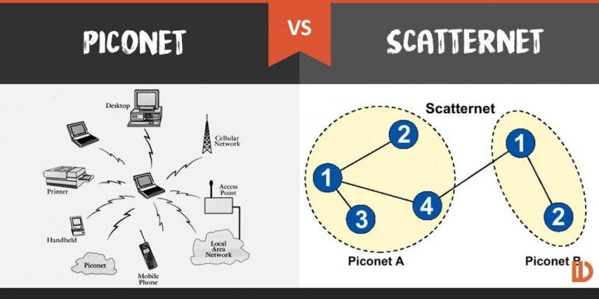
Ad-hoc-networking
https://medium.com/@kashifnoor/bluetooth-ad-hoc-and-piconet-f7d5b9b027a9

Slide 84
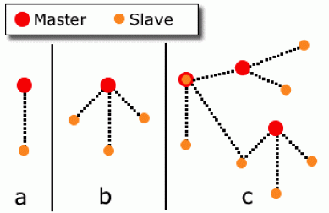
Ad-hoc-networking
a: piconet with a single slave
b: piconet with a multi slave
c: scatternet

Slide 85
Products that use Ad-hoc-networking
Notebook PCs & desktop computers
Printers
PDAs
Other handheld devices
Cell phones
Wireless periperals:
Headsets
Cameras
Access Points
CD Player
TV/VCR/DVD
Telephone Answering Devices
Cordless Phones
Cars

Slide 86
Bluetooth
Bluetooth wireless technology along with infrared is an open specification for a low-cost, low-power, short-range radio technology for ad-hoc wireless network communication surroundings during which network is created spontaneously - for voice and data.

Slide 87
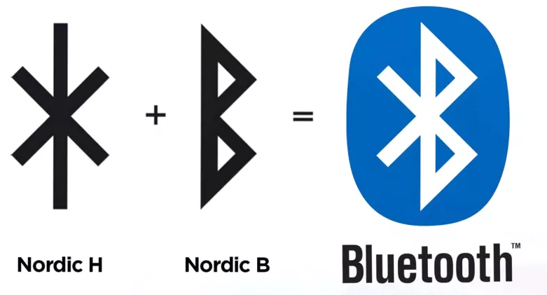
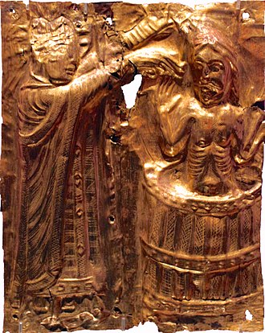
Bluetooth - History
Bluetooth project was started by SIG (Special Interest Group) formed by four companies IBM, Intel, Nokia and Toshiba for interconnecting computing and communicating devices using short-range, lower-power, inexpensive wireless radios.
• The project was named Bluetooth after the name of Viking king – Harald Blaat and who unified Denmark and Norway in 10th century.
King of Denmark, Harald "Bluetooth" Gormsson – a name said to refer to his dead tooth.

Slide 88
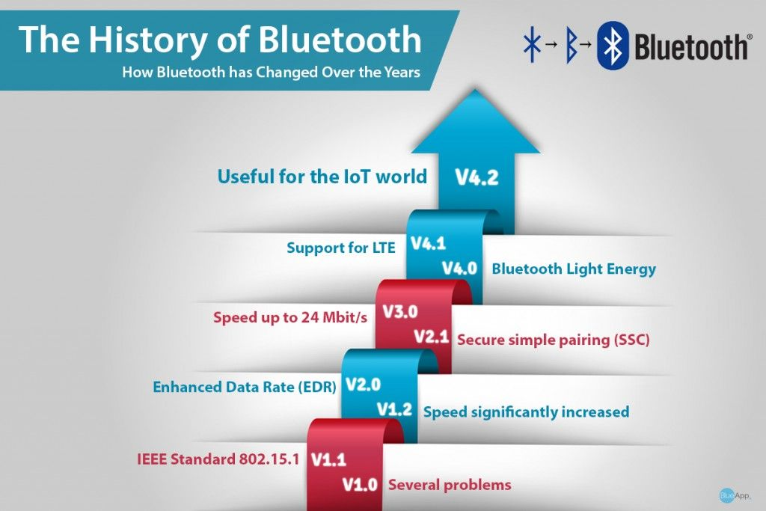

Slide 89
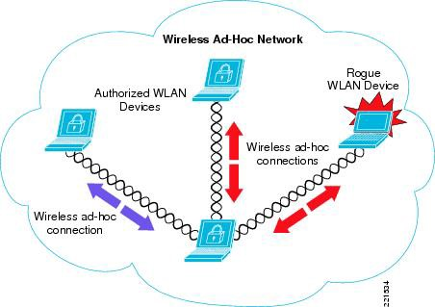
Bluetooth
Originally conceived as a cable replacement technology
Other usage models began to develop:
Personal Area Network (PAN)
Ad-hoc networks
Data/voice access points
Wireless telematics

Slide 90
Bluetooth - Webpages for additional reading
https://www.gearbrain.com/how-do-bluetooth-devices-work-2645015200.html
https://ecomputernotes.com/computernetworkingnotes/communication-networks/bluetooth
https://www.creativebloq.com/news/bluetooth-logo-secret

Slide 91
Wireless Fidelity (Wi-Fi)
Wireless Technology is an alternative to Wired Technology, which is commonly used, for connecting devices in wireless mode.
A Wi-Fi is any electronic device, such as a personal computer, video game console, Smartphone, or digital audio player can connect to the internet via a wireless network access point.
An access point (or hotspot) has a range of about 20 meters (65 feet) indoors as few rooms and a greater range outdoors, as many square miles.
Wi-Fi access can provide at Organizations and businesses such as homes, offices, airports, hotels and restaurants often provide free-use hotspots to attract or assist clients.

Slide 92
Wireless Fidelity (Wi-Fi)
There are three most important items which makes Wi-Fi working in your laptop or desktop. These are Radio Signals, Wi-Fi Card which fits in your laptop or computer.
Hotspots which create Wi-Fi Network.
Wi-Fi (Wireless Fidelity) is a generic term that refers to the IEEE 802.11 communications standard for Wireless Local Area Networks (WLANs).
The 802.11 standard is defined through several specifications of WLANs such as,
IEEE 802.11b
IEEE 802.11a
IEEE 802.11g

Slide 93
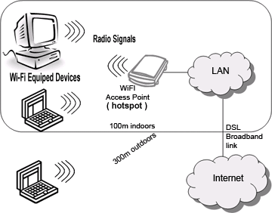

Wireless Fidelity (Wi-Fi)

Slide 94
Wireless Fidelity (Wi-Fi)
Basic concept is same as Walkie talkies.
A Wi-Fi hotspot is created by installing an access point to an internet connection.
An access point acts as a base station.
When Wi-Fi enabled device encounters a hotspot the device can then connect to that network wirelessly.
A single access point can support up to 30 users and can function within a range of 100 – 150 feet indoors and up to 300 feet outdoors.
Many access points can be connected to each other via Ethernet cables to create a single large network.

Slide 95
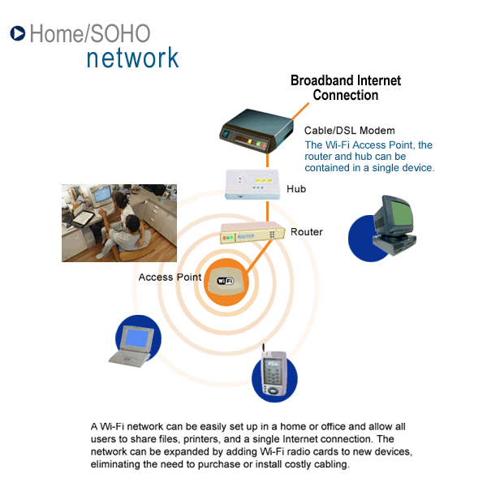
Whole house connectivity

Slide 96
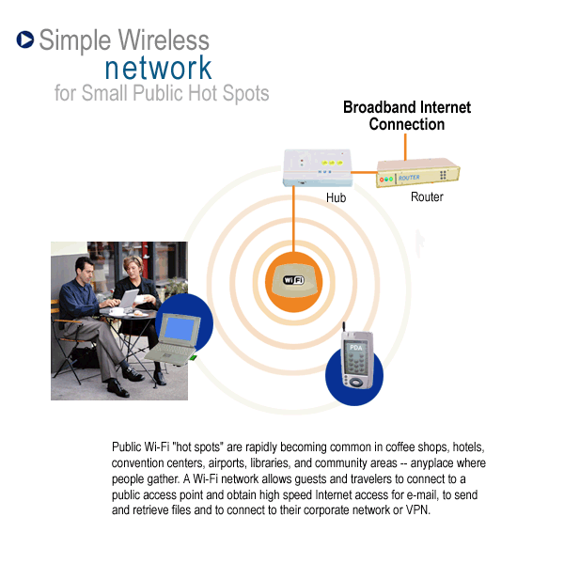
Public place connectivity

Slide 97
Advantages
Mobility
Ease of Installation
Flexibility
Cost
Reliability
Security
Use unlicensed part of the radio spectrum
Roaming
Speed

Slide 98
Protocols

Slide 99
Protocols
Protocols define
format,
order of messages sent and received among network entities,
actions taken on message transmission, receipt
All communication activity over the Internet are governed by protocols.

Slide 100
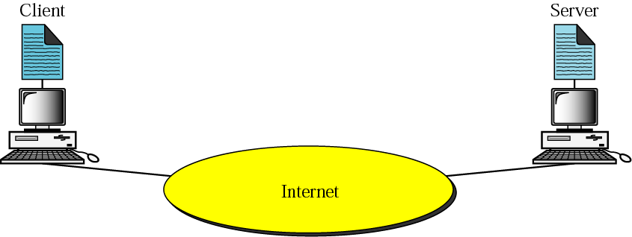
Client-server model
To make any use of the Internet, application programs should run on the two endpoints of a network connection.
The applications are the entities that communicate with each other to exchange services
“Client” applications request service
“Server” applications provide service.

Slide 101

Client-server model
Servers
Run all the time (i.e. infinite)
Provide service to any client
Typically specialize in providing a certain type of service, e.g. Mail.
Listen to a well-known port and passively open connection.
Clients
Run when needed, then terminate (i.e. finite)
Actively Open TCP or UDP connection with Server’s socket.

Slide 102
Client-server model - Operation Mode
Operation mode could be either iterative or concurrent.
In clients:
Iterative mode: One client at-a-time in serial
Concurrent mode: Several clients run at the same time
In servers:
Iterative mode: serve one client at-a-time (clients wait in a queue)
Concurrent mode: serve multiple clients concurrently and independently.

Slide 103
What is a protocol?
In diplomatic circles, a protocol is the set of rules governing a conversation between people
We have seen that the client and server carry on a machine-to-machine conversation
A network protocol is the set of rules governing a conversation between a client and a server
There are many protocols, HTTP is just one.
Notes:
Follow protocol – follow the rules of the conversation

Slide 104
An HTTP Conversation
Client
Server
OK
Send page or error message
OK
I would like to open a connection
GET <file location>
Display response
Close connection
HTTP is the set of rules governing the format and content of the conversation between a Web client and server

Slide 105
Network protocols
The details are only important to developers.
The rules are defined by the inventor of the protocol – may be a group or a single person.
The rules must be precise and complete so programmers can write programs that work with other programs.
The rules are often published as an RFC along with running client and server programs.
The HTTP protocol used for Web applications was invented by Tim Berners Lee.
RFC = request for comments

Slide 106
HTTP vs HTML
HTML: hypertext markup language
Definitions of tags that are added to Web documents to control their appearance
HTTP: hypertext transfer protocol
The rules governing the conversation between a Web client and a Web server
Both were invented at the same time by the same person

Slide 107
The application layer is boss – the top layer
Layer | Function
Application | Do useful work like Web browsing, email, and file transfer
Lower layers | Handle communication between the client and server
Your boss says: Send this package to Miami -- I don't care if you use Federal Express, UPS, or any other means. Also, let me know when it arrives or if it cannot be delivered for some reason.
The application program says: Send this request to the server -- I don't care how you do it or whether it goes over phone lines, radio, or anything else about the details. Just send the message, and let me know when it arrives or if it cannot be delivered for some reason.
There are five TCP/IP layers, the application layer and four lower layers.

Slide 108
Application layer protocols used on the Internet
Protocol | Application
HTTP: Hypertext Transfer | Retrieve and view Web pages
FTP: File Transfer | Copy files from client to server or from server to client
SMTP: Simple Mail Transport | Send email
POP: Post Office | Read email

Slide 109

HTTP protocol
The Web client and the Web server are application programs
Application layer programs do useful work like retrieving Web pages, sending and receiving email or transferring files
Lower layers take care of the communication details
The client and server send messages and data without knowing anything about the communication network

Slide 110
Message Queuing Telemetry Transport [MQTT] Protocol
https://mqtt.org/
https://youtu.be/z4r4hIZcp40

Slide 111
IoT Application Layer Protocols
Most popular application layer protocols used nowadays:
CoAP: Constrained Application Protocol
MQTT: Message Queuing Telemetry Transport
XMPP: Extensible Messaging and Presence Protocol
AMQP: Advanced Message Queuing Protocol
WebSocket: Computer Communications Protocol
Alljoyn: Full stack of protocols intended for IoT. Not separable application layer protocol

Slide 112

MQTT
Introduced by IBM
Standardized by OASIS (2013)
Uses Publish/Subscribe mechanism controlled by Broker
Broker
Software component
Responsible for distributing messages from Publishers to interested Subscribers
The Organization for the Advancement of Structured Information Standards (OASIS; /oʊˈeɪ.sɪs/) is a nonprofit consortium that works on the development, convergence, and adoption of open standards for cybersecurity, blockchain, Internet of things (IoT), emergency management, cloud computing, legal data exchange, energy, content technologies, and other areas.

Slide 113

MQTT
MQTT was co-invented by IBM and Arcom Systems over 13 years ago.
Abstract from the MQTT spec web site: The MQ Telemetry Transport (MQTT) protocol is a lightweight publish/subscribe protocol flowing over TCP/IP for remote sensors and control devices through low bandwidth, unreliable or intermittent communications.
This protocol specification has not been standardized.
It is made available under a royalty free license

Slide 114
Why MQTT?
Lightweight and Efficient
MQTT clients are very small, require minimal resources so can be used on small microcontrollers.
MQTT message headers are small to optimize network bandwidth.
Bi-directional Communications
MQTT allows for messaging between device to cloud and cloud to device.
This makes for easy broadcasting messages to groups of things.
Scale to Millions of Things
MQTT can scale to connect with millions of IoT devices.

Slide 115
Why MQTT? [contd.]
Reliable Message Delivery
Reliability of message delivery is important for many IoT use cases.
This is why MQTT has 3 defined quality of service levels: 0 - at most once, 1- at least once, 2 - exactly once
Support for Unreliable Networks
Many IoT devices connect over unreliable cellular networks.
MQTT’s support for persistent sessions reduces the time to reconnect the client with the broker.
Security Enabled
MQTT makes it easy to encrypt messages using TLS and authenticate clients using modern authentication protocols, such as OAuth.

Slide 116

MQTT Publish / Subscribe Architecture
https://mqtt.org/

Slide 117

MQTT component details
Many – to – many Sub to Pub relationship
One Broker for every system
Subs authenticated to Broker
Subs/Pubs can be very constrained
Pub can be even only a sensor
Broker has to provide more computational power

Slide 118

MQTT Versions
MQTT-SN (sensor networks)
S-MQTT (designed in such a way that it can be run on low-end and battery-operated sensor/actuator devices and operate over bandwidth-constraint WSNs such as ZigBee-based network)s

Slide 119

Access Control
What
Restrictions in order to enforce policies
Effect
Permission/Denial of access to a specific resource

Slide 120

Access Control Policy
Set of rules that allow/deny access
Rules depend on attributes
Access control evaluates attributes only once at request time
NIS uses a simple key-to-entry query scheme to find data. LDAP uses a flexible, but complex, base/scope/filter search criteria.
NIS does not perform authentication. LDAP performs authentication.

Slide 121

LDAP
LDAP (Lightweight Directory Access Protocol) is a software protocol for enabling anyone to locate data about organizations, individuals and other resources such as files and devices in a network -- whether on the public Internet or on a corporate Intranet.

Slide 122

Attribute mutability
Conditions may change during time
So do attributes
New attribute values may affect conditions
What if they violate policy?

Slide 123

MQTT in Action
https://mqtt.org/use-cases/#automotive

Slide 124
AM / FM

Slide 125
What is Modulation?
It is a process in a communication system. An electronic communication system converts our message (information) into an electronic signal and the electronic signal is carried out by carrier waves to the destination.
One element in communication is a high-frequency carrier wave and the other is the information that has to be transmitted (modulating signal) (or) input signal. These are essential for communication which is done using a device from one place to another.
In order that a radio signal can carry audio or other information for broadcasting or for two way radio communication, it must be modulated or changed in some way.
Although there are a number of ways in which a radio signal may be modulated, one of the easiest is to change its amplitude in line with variations of the sound.

Slide 126

AM / FM - What is Modulation?

Slide 127


AM - What is Amplitude Modulation?
Amplitude modulation or just AM is one of the earliest modulation methods that is used in transmitting information over the radio.
This technique was devised in the 20th century at a time when Landell de Moura and Reginald Fessenden were conducting experiments using a radiotelephone in the 1900s. After successful attempts, the modulation technique was established and used in electronic communication.

Slide 128
AM/FM
Amplitude Modulation
Amplitude modulation is a modulation technique where the amplitude of a carrier varies depending on the information signal. AM radio broadcast signals use lower carrier frequencies, this helps them to travel long distances. Sometimes AM signals can be able to bounce off the ionosphere. The distance traveled by the AM is much larger than the FM.
Frequency Modulation
In this module, the frequency of the carrier wave is modified according to the signal that carries information. The radio signals have large bandwidth than AM radio signals, which helps to offer much better sound quality. Frequency modulation also enables to transmit stereo signals.

Slide 129

AM/FM
For instance, if several different sets of data are required to be transmitted using the same medium, then each set off is sent using different frequency waves. This is the process of how radio broadcasts are done.

Slide 130
AM/FM
FM radio works the same way that AM radio works. The difference is in how the carrier wave is modulated, or altered.
With AM radio, the amplitude, or overall strength, of the signal is varied to incorporate the sound information. With FM, the frequency (the number of times each second that the current changes direction) of the carrier signal is varied.
FM signals have a great advantage over AM signals. Both signals are susceptible to slight changes in amplitude. With an AM broadcast, these changes result in static. With an FM broadcast, slight changes in amplitude don't matter -- since the audio signal is conveyed through changes in frequency, the FM receiver can just ignore changes in amplitude. The result: no static at all.

Slide 131

AM
https://www.physics-and-radio-electronics.com/blog/amplitude-modulation/

Slide 132
AM - Advantages
Few components needed: At the receiver side, the original signal is extracted (demodulated) using a circuit consisting of very few components.
2. Low cost: The components used in amplitude modulation is very cheap. So the AM transmitter and AM receiver build at low cost.
3. It is simple to implement.
4. Long distance communication: Amplitude modulated waves can travel a longer distance.

Slide 133
AM - Disadvantages
1. Amplitude modulation is inefficient in terms of its power usage: As we know that the message signal contains information whereas the carrier signal does not contain any information. In amplitude modulation, most of the power is concentrated in the carrier signal which contains no information. At the receiver side, the power consumed by the carrier wave is wasted.
2. It requires high bandwidth: The amplitude modulation is not efficient in terms of its use of bandwidth. It requires a bandwidth equal to twice that of the highest audio signal frequency.
3. This type of transmission can be easily affected by the external radiation.
4. This type of transmission is also affected by the man-made noises or radiations like waves from other antennas or channels.
5. Amplitude modulation (AM) cannot be used for transmitting music as done by frequency modulation (FM).
6. Amplitude modulation cannot be used for transmission of sensitive information like in the army, where interpretation or loss or disruption during transmission is not an option.

Slide 134
AM - Disadvantages
3. This type of transmission can be easily affected by the external radiation.
4. This type of transmission is also affected by the man-made noises or radiations like waves from other antennas or channels.
5. Amplitude modulation (AM) cannot be used for transmitting music as done by frequency modulation (FM).
6. Amplitude modulation cannot be used for transmission of sensitive information like in the army, where interpretation or loss or disruption during transmission is not an option.

Slide 135
AM - Applications
1. Air band radio: The amplitude modulation is extensively used in aerospace industry. The VHF (Very High Frequency) transmissions made by the airborne equipment still use amplitude modulation. The radio contact between ground to ground and also ground to air use amplitude modulated (AM) signals.
2. Broadcast transmission: Amplitude modulation (AM) is still widely used for broadcasting either short or medium or long wave bands.
3. Quadrature amplitude modulation: Amplitude modulation is used in the transmission of data of almost everything, from short-range transmission such as wifi to cellular communications. Quadrature amplitude modulation is formed by mixing two carriers that are out of phase by 90°.
4. Single sideband: The amplitude modulation (AM) in the form of single sideband is still used for HF (High Frequency) radio links.

Slide 136

FM
https://www.physics-and-radio-electronics.com/blog/frequency-modulation/

Slide 137
FM - Advantages & Disadvantages
Advantages
1. All the power transmitted in frequency modulation is useful whereas in amplitude modulation, most of the power is in carrier (which is useless).
2. Adjacent channel interference does not takes place in frequency modulation.
3. High signal to noise ratio (S/N). In simple words, it has less noise.
Drawbacks of Frequency modulation
It requires wider bandwidth than amplitude modulation.

Slide 138
FM - Applications
1. FM broadcasting
2. Radar
3. Magnetic tape recording systems
4. Telemetry
5. Two-way radio systems
6. Music synthesis
7. Seismic prospecting
8. Video transmission systems

Slide 139

AM/FM

Slide 140

Oscilloscope

Slide 141
Oscilloscope - (O-scope for short)
An oscilloscope is a type of electronic test instrument that can graphically display signal voltage changes. Other signals (such as sound or vibration) can be converted to voltages and displayed on the screen of the oscilloscope.
Engineers use oscilloscopes to study the changing process of various electrical phenomena for laboratory work. It can be used to capture, process, display and analyze the waveform and bandwidth of electronic signals.
They graph an electrical signal as it varies over time and produces a 2D graph with the x-axis being time and y-axis being voltage.
https://www.seeedstudio.com/blog/2020/03/25/introduction-to-the-oscilloscope-what-is-an-oscilloscope-and-how-to-use-it/

Slide 142
Basic Oscilloscope Functions
Displays and calculate the frequency and amplitude of an oscillating signal on a graph.
Displays the voltage and time of a particular signal.
Troubleshoot any possible malfunction components of your project by looking at the expected output of a particular component. (See whether a malfunctioning component is distorting the signal
Show how much of a signal is direct current (DC) or alternating current (AC).
In an Oscilloscope, there are controls surrounding the scope’s screen. They can be used to adjust the scale of the graph (vertically and horizontally) which lets you zoom in and out on a signal. There are also trigger controls for you to stabilize and display a repetitive waveform

Slide 143
Displays and calculate the frequency and amplitude of an oscillating signal on a graph.
Displays the voltage and time of a particular signal.
Troubleshoot any possible malfunction components of your project by looking at the expected output of a particular component. (See whether a malfunctioning component is distorting the signal
Show how much of a signal is direct current (DC) or alternating current (AC).
If you look at an Oscilloscope, there will be controls surrounding the scope’s screen. They can be used to adjust the scale of the graph (vertically and horizontally) which lets you zoom in and out on a signal. There are also trigger controls for you to stabilize and display a repetitive waveform

